Slide 1

DIVISION OF ARTICIAL SCIENCE AND ENGINEERING
SCHOOL OF COMPUTER SCIENCE AND TECHNOLOGY
22AI2999 PROJECT
EVEN SEMESTER 2025-2026
FINAL REVIEW- 28/04/2026
PROMPT FIXER: An AI-based System for Improving and
structuring User Prompts for Language Model
SUPERVISED BY:
BRISO BECKY BELL J
ASSITANT PROFESSOR
PRESENTED BY:
MEDAMANOORI DHANUSH
URK22CS7062

Slide 2

ABSTRACT
The Prompt Fixer system is designed to improve the quality of user prompts for effective interaction with large language models (LLMs). Users often provide vague or unstructured inputs, leading to inaccurate outputs. This system uses machine learning for intent detection and toxicity filtering, along with a transformer-based model for prompt optimization. It enhances clarity, preserves user intent, ensures safety, and evaluates performance using multiple metrics, resulting in more reliable and meaningful AI-generated responses.

Slide 3
INTRODUCTION
Large language models mainly depend on the quality of user input to generate accurate responses. However, many users provide prompts that are unclear, incomplete, or poorly structured, leading to inconsistent and unreliable outputs. Additionally, there is a lack of automated systems to refine prompts, ensure safety, and evaluate their effectiveness, which limits the overall performance and usability of AI-based systems.

Slide 4
PROBLEM STATEMENT
Large language models depend on clear and well-structured prompts to generate accurate results. However, users often provide vague or poorly written inputs, leading to incorrect or unclear outputs. There is no proper system to automatically improve prompts and ensure safe usage, which reduces the effectiveness of AI applications.

Slide 5
OBJECTIVES
Aim of the Project:
To improve the clarity and structure of user prompts for better LLM responses
To detect user intent accurately using machine learning techniques
To identify and filter harmful or unsafe inputs
To optimize prompts while preserving the original meaning
To evaluate prompt quality using multiple performance metrics

Slide 6
ALGORITHMS USED
Intent Detection
Uses Logistic Regression
Converts input text into numerical features
Classifies user prompt into categories (query, task, etc.)
Helps the system understand user purpose
Enables context-aware prompt optimization
Toxicity Detection
Uses Random Forest Classifier
Identifies harmful or unsafe inputs
Classifies prompts as toxic or non-toxic
Blocks malicious or inappropriate content
Ensures safe and ethical system usage
Prompt Rewriting
Uses Transformer Model (Gemma via Ollama)
Improves clarity, grammar, and structure
Adds necessary context to incomplete prompts
Preserves original meaning and intent
Generates optimized, LLM-friendly prompts

Slide 7
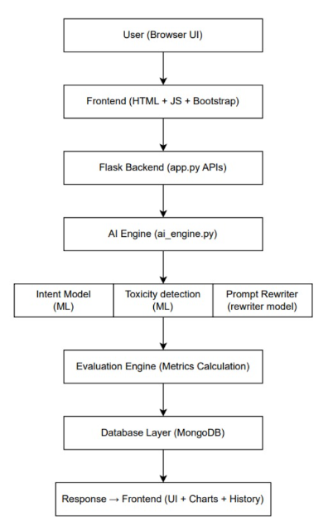
PROPOSED SYSTEM ARCHITECTURE
The Prompt Fixer system follows a modular architecture that processes user input through multiple stages. The input is first checked for safety and intent using machine learning models, then optimized using a transformer-based model to improve clarity and structure. Finally, the output is evaluated and displayed to the user, ensuring reliable and effective prompt enhancement.

Slide 8
MODULE DESCRIPTION
1. Input & Preprocessing Module
Accepts user input and cleans text for further processing.
2. Intent Detection Module
Classifies user prompt into categories using machine learning techniques.
3. Toxicity Detection Module
Detects harmful content and blocks unsafe or malicious user inputs.
4. Prompt Rewriting Module
Rewrites prompts using transformer model for clarity and structure.
5. Safety Module
Identifies prompt injection attempts and prevents misuse of the system.
6. Evaluation Module
Evaluates optimized prompts using semantic, structural, and performance metrics.

Slide 9
Evaluation Metrics
BERT SCORE:
BERT Score measures deep contextual similarity using embeddings from a transformer model.
BELU SCORE:
BELU (Bilingual Evaluation Understudy) measures how similar the word structure of the optimized prompt is to the original.
READIBILITY INDEX:
Measure how east to read and understand based on sentence length and word complexity
Output format:
G12 → G8 (G12=hard G8=easy)

Slide 10
CONCLUSION
The Prompt Fixer system effectively enhances the quality of user prompts by improving clarity, structure, and context while preserving the original intent. By integrating machine learning models, transformer-based optimization, and safety mechanisms, the system ensures reliable and secure interactions with large language models. The results demonstrate improved prompt effectiveness and overall system performance, making it a practical solution for real-world AI applications.

Slide 11
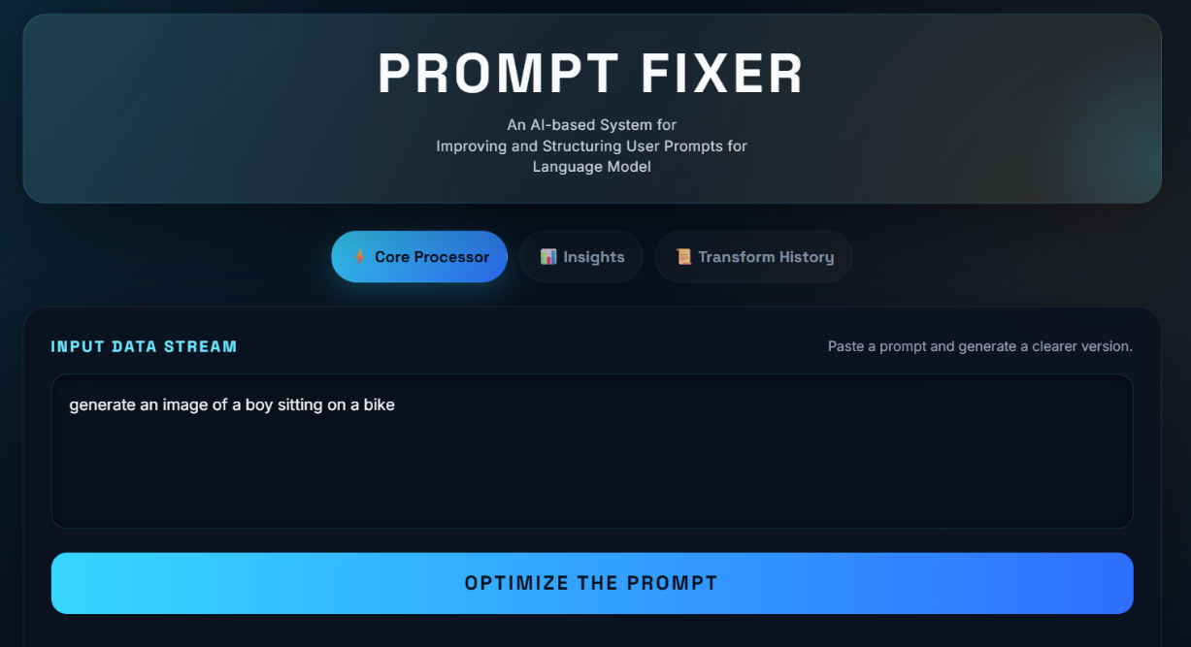
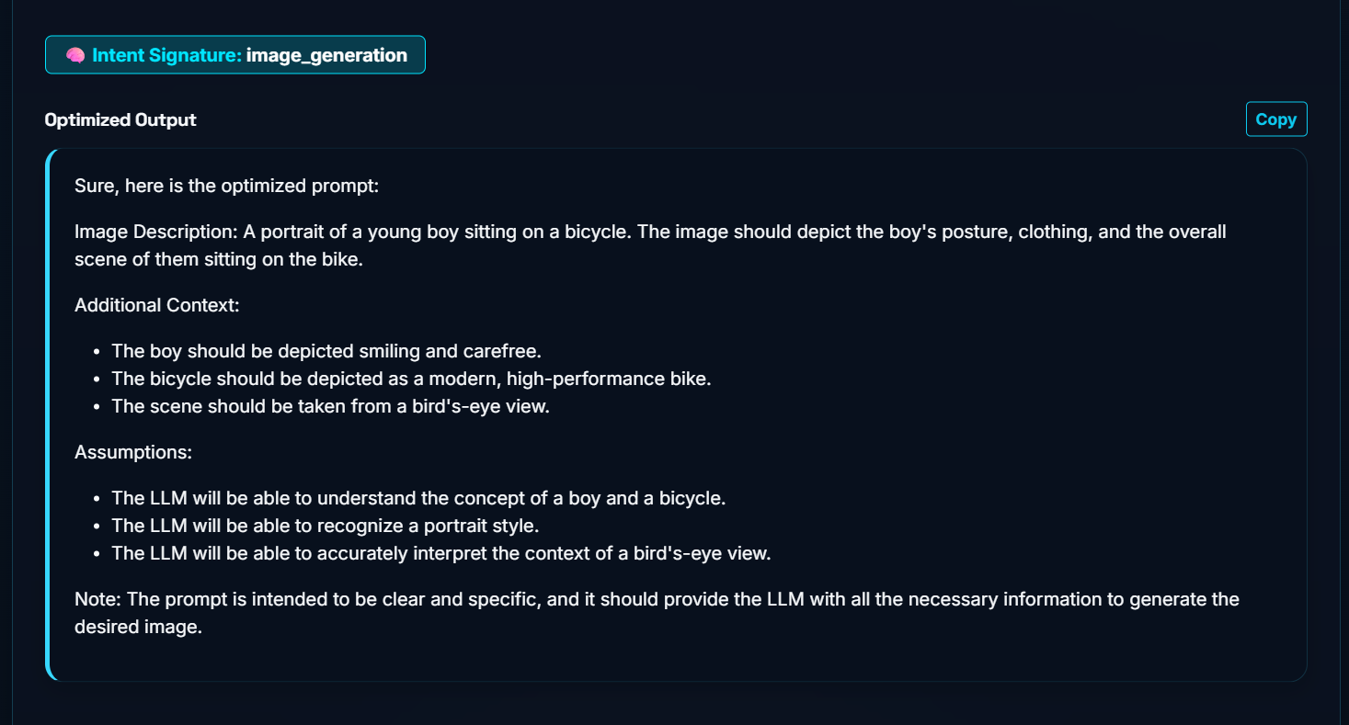
OUTPUT-SCREENSHOTS

